Slide 1



Bill
Management System
-Sumayya Nazneen-

Slide 2

Bill management system
Submitted by: Sumayya Nazneen
(Reg. No: U04AX21S0094)
Under the guidance of: Miss.Shilparani Khindimath
Doddappa Appa College of BCA, Basavakalyan
Date: August 2024

Slide 3



Introduction
Requirement Engineering
Design and Methodology
Visual Tools
Implementation
Results
Conclusion
References
Contents

Slide 4


•1. Objective of the Project:
•Provide a detailed analysis of household expenditures on electricity, DTH, and water bills.
•2. Purpose of the Project:
•Empower households to optimize utility expenses and promote sustainability.
•3. Problem Statement:
•Address inefficiencies in utility management to foster better financial and environmental practices.
Introduction

Slide 5

Requirement Engineering
•1. Understanding the Purpose:
•Analyze the expenditures on electricity, DTH, and water.
•2. Gathering Requirements:
•Collect data from utility providers, billing statements, and household records.

Slide 6
Design and Methodology
•1. Data Collection:
•Gather data from utility providers and household records.
•2. Data Organization:
•Organize data for electricity, DTH, and water bills separately.
•3. Analysis Framework:
•Analyze consumption patterns and cost breakdowns.

Slide 7
Visual Tools
•1. Bar Charts:
•Visualize cost breakdowns for different utilities.
•2. Line Graphs:
•Show consumption patterns over time.
•3. Pie Charts:
•Compare expenditures across months.
•4. Infographics:
•Convey recommendations for cost savings.

Slide 8

Implementation
•1. Software Requirements:
•Spreadsheet software, word processing tools, and statistical software.
•2. Hardware Requirements:
•Standard desktop or laptop with basic specifications.

Slide 9
Results
•1. Home Page of Site:
•Overview of the web interface for bill management.
•2. Database Tables:
•Tables storing data on electricity, DTH, and water bills.
•3. ER Diagram and Schema Diagram:
•Visual representation of the database structure.

Slide 10

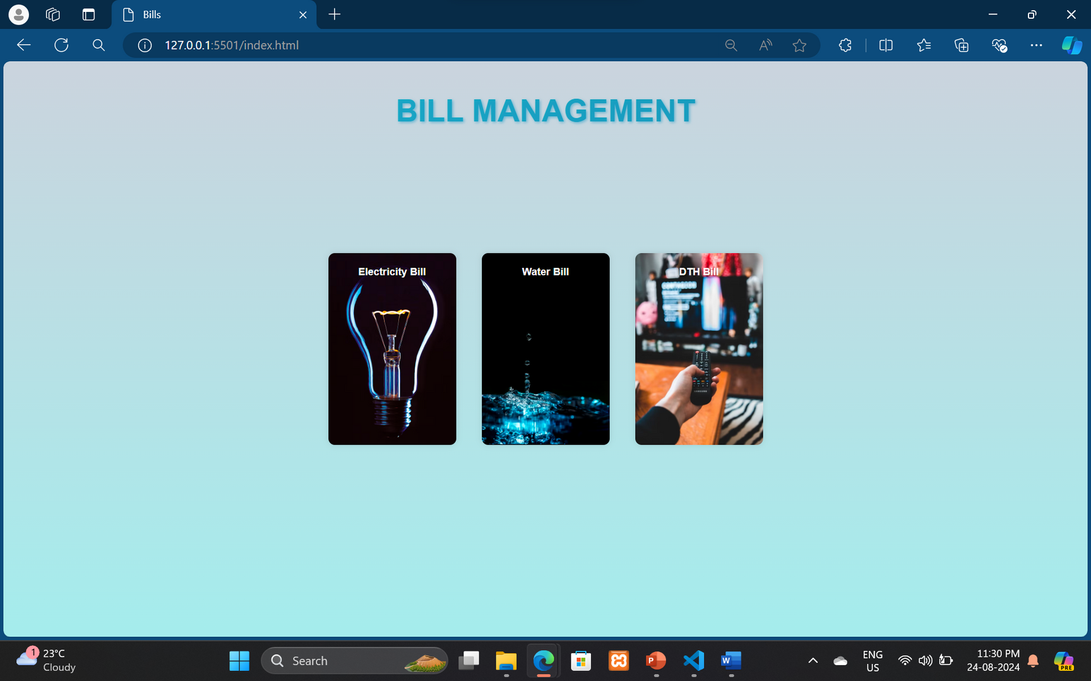
Home page

Slide 11
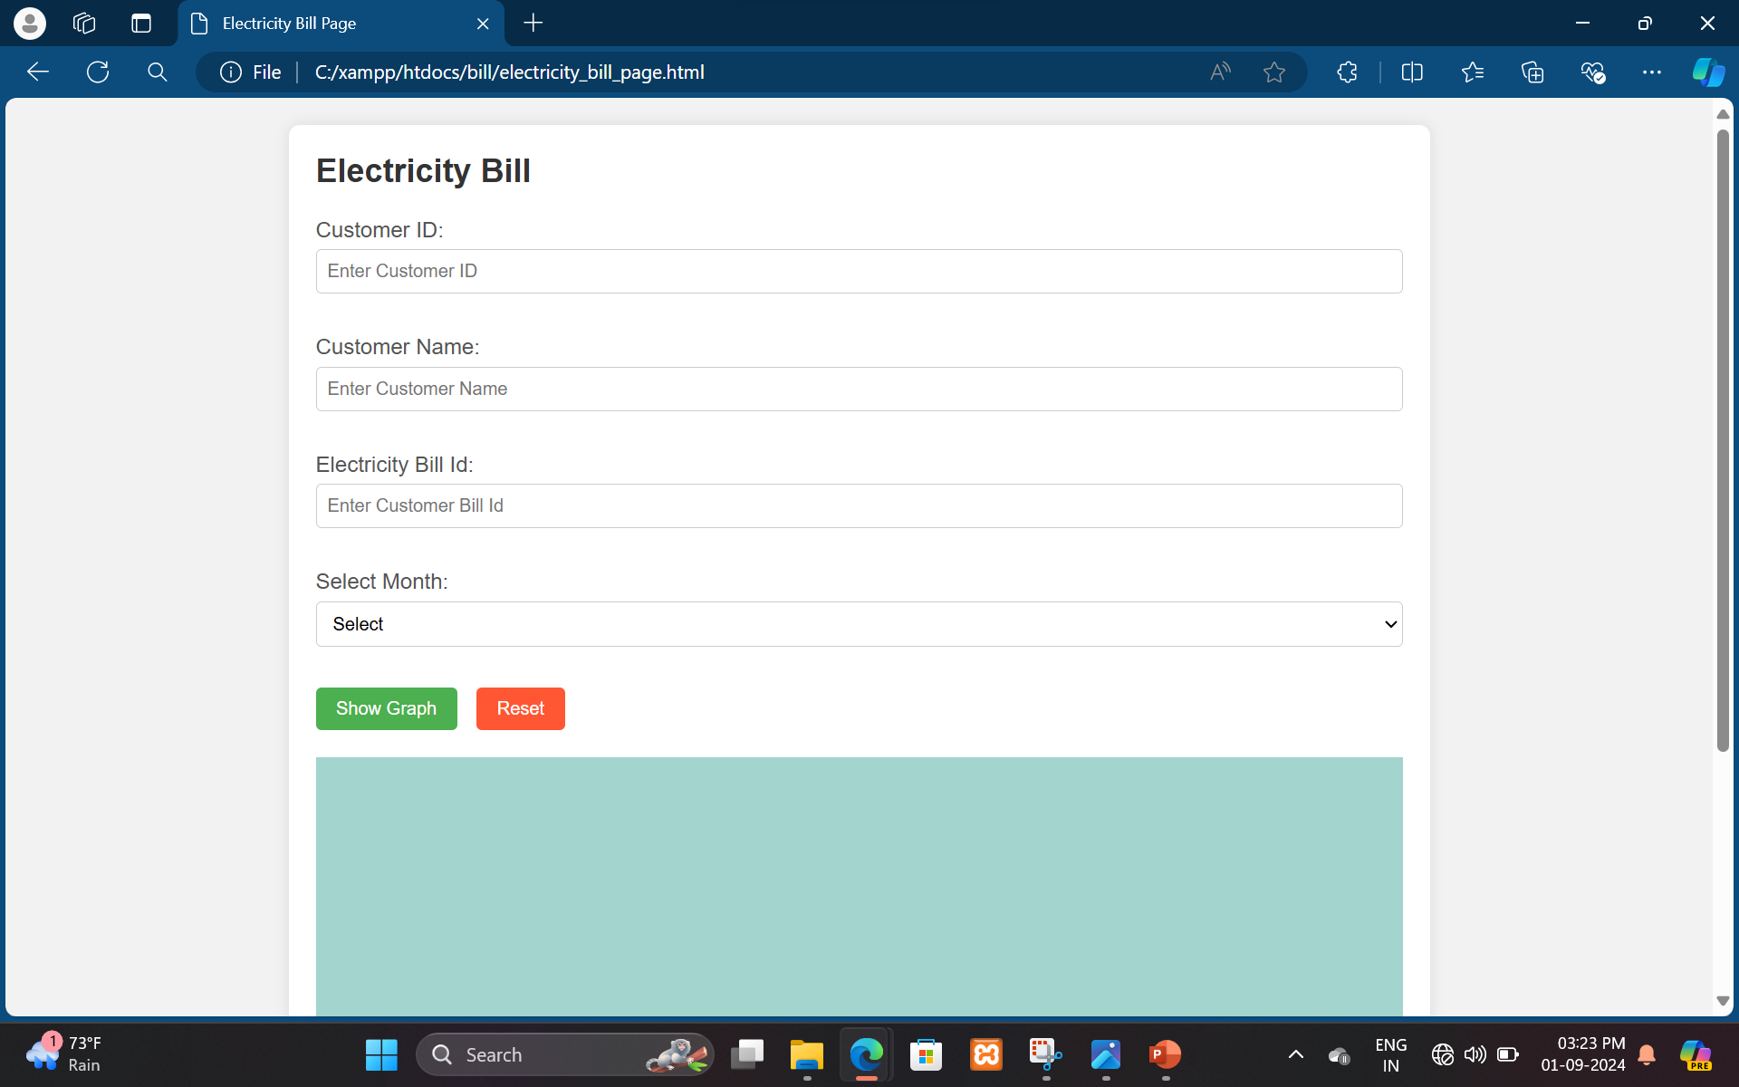
Fields

Slide 12
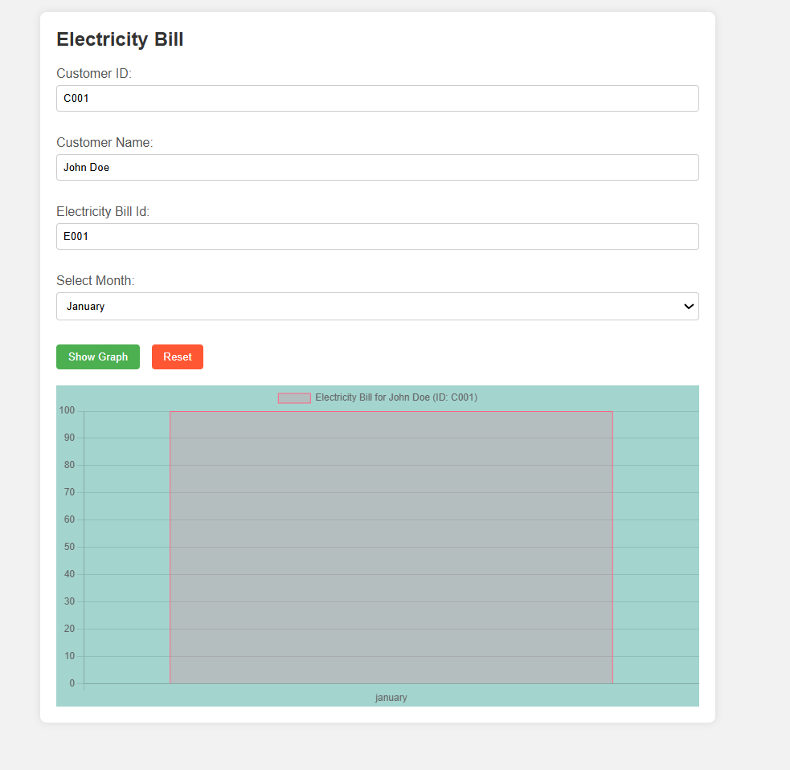
Output

Slide 13
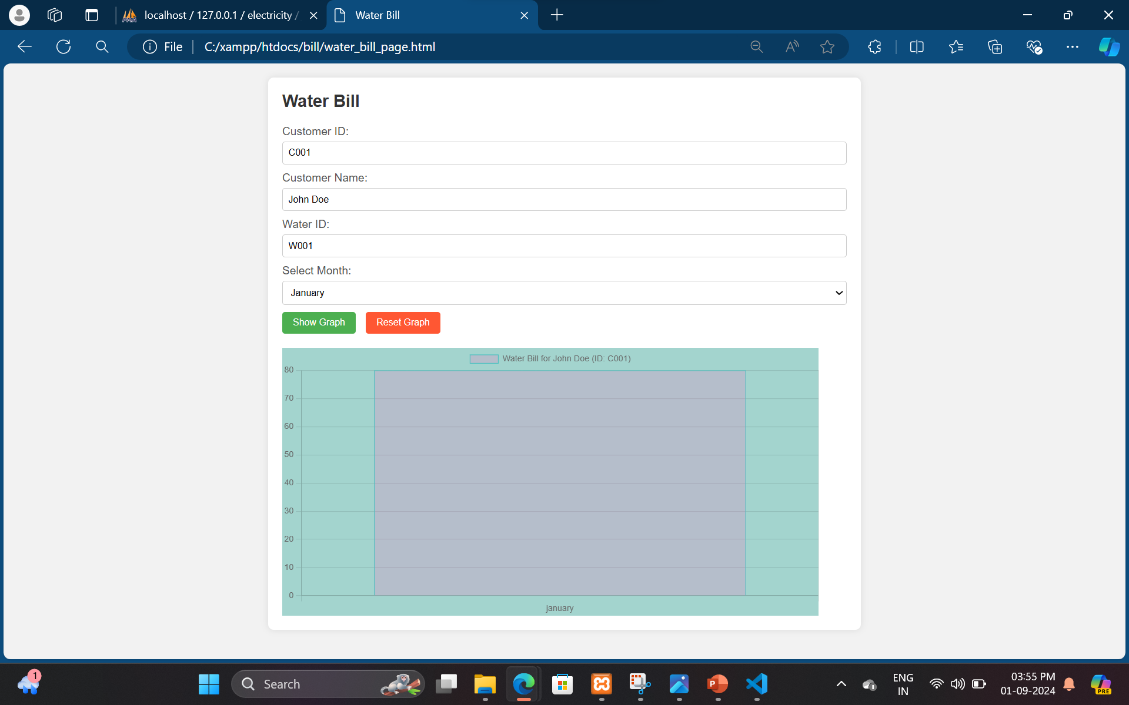
Water Bill

Slide 14
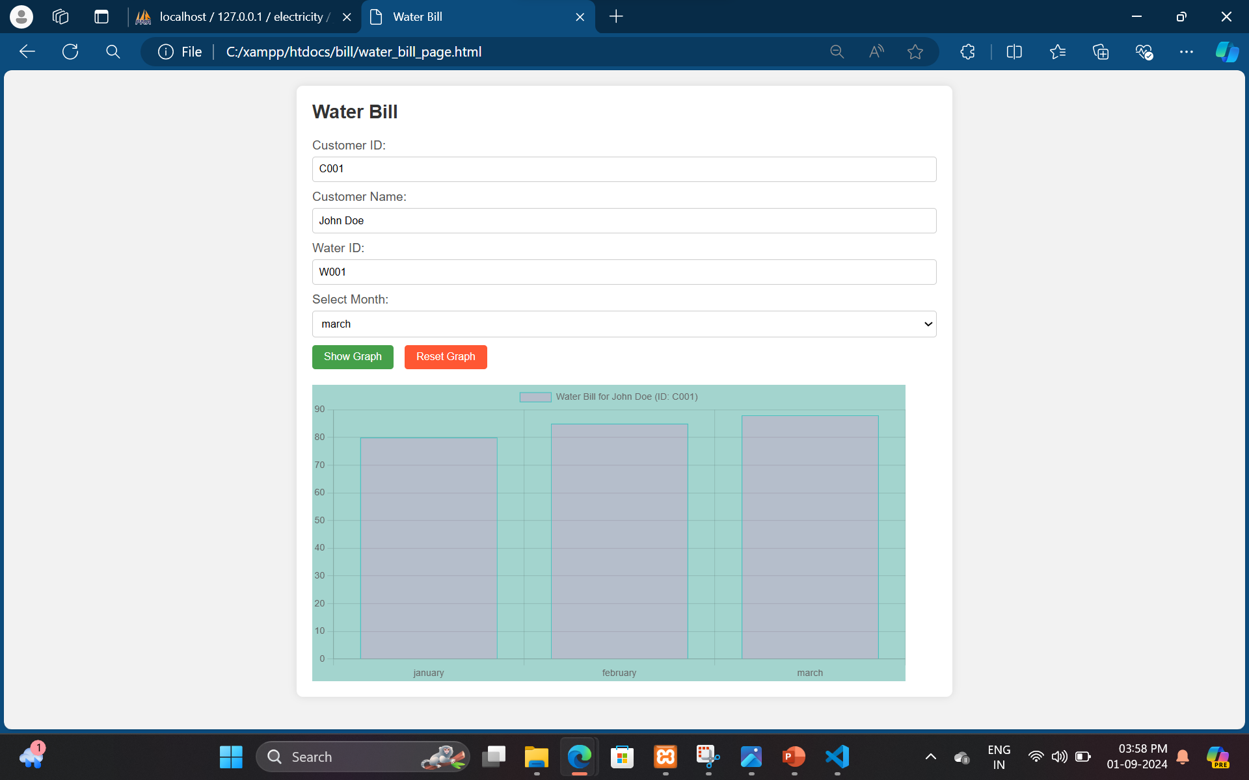

Slide 15
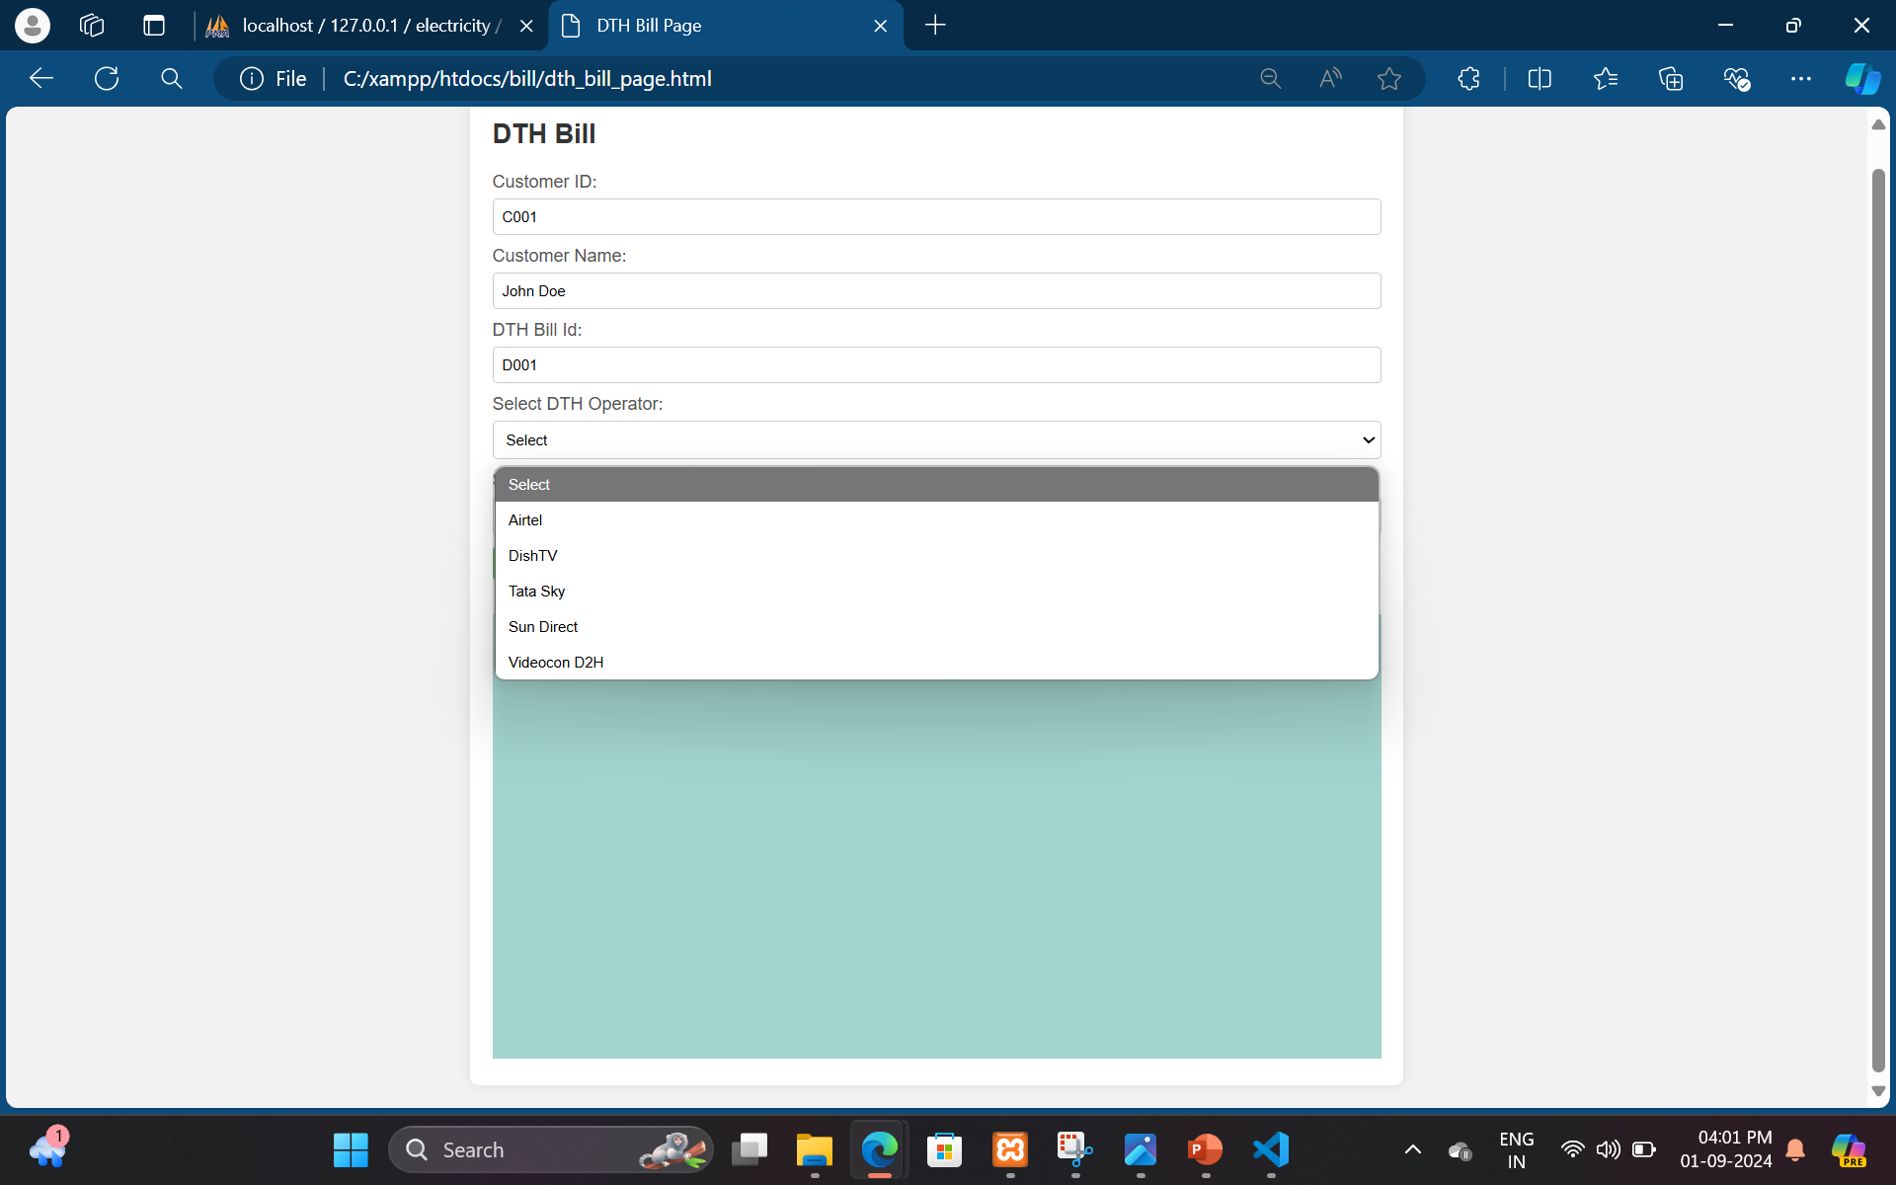
DTH Bill

Slide 16
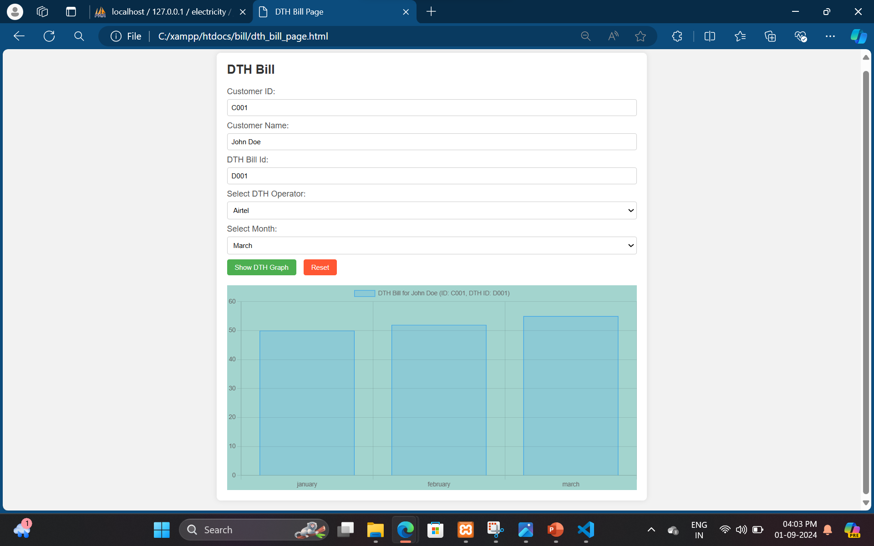

Slide 17
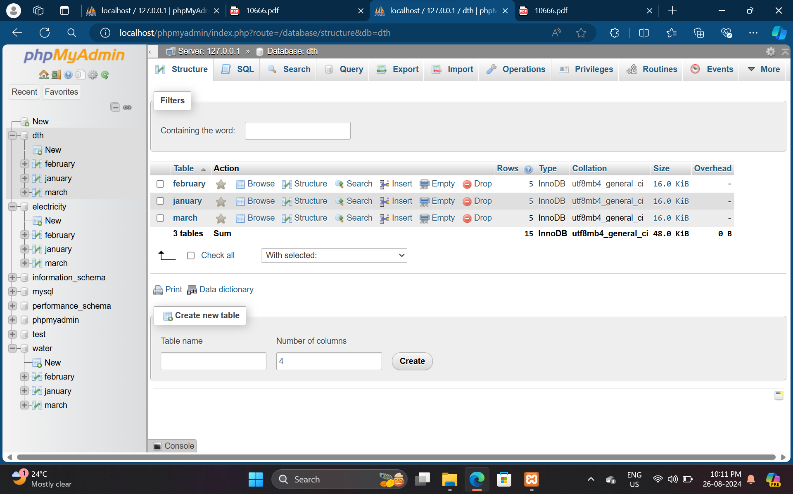
Database

Slide 18
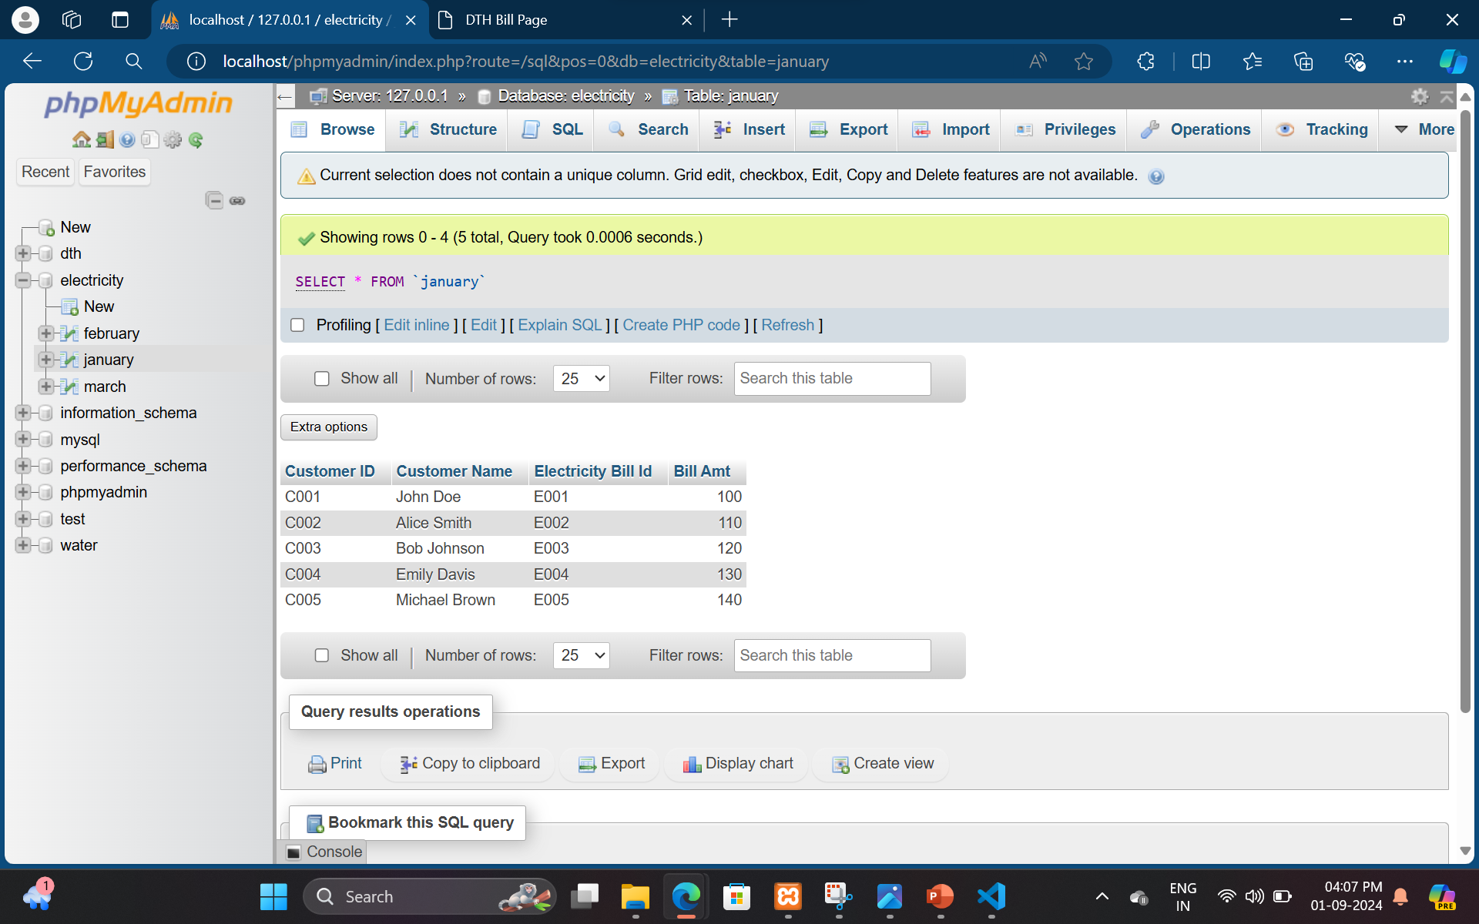

Slide 19
Conclusion
•The report emphasizes the importance of managing household utilities effectively. Through analysis, households can reduce expenses and promote sustainability. Proactive monitoring and optimization are key to achieving financial stability and environmental conservation.

Slide 20
References
•1. Xampp installation: https://www.apachefriends.org/index.html
•2. Web Development tutorials: https://www.w3schools.com/
•3. Design ideas: https://trainings.internshala.com/
•4. DBMS tutorials: http://vtucode.in
•5. Other tutorials: https://www.youtube.com

Slide 21

Thank
you

